Slide 1
Food Trends Understanding Customer Preferences
Infosys Springboard Data Visualization Domain Internship Batch – 11 Group-1
Domain: Data Visualization
Mentor:
MS Nityasree
Presentation By: Vasanthi Kakkera

Slide 2
Objective and Description
Objective: To architect a multi-layered PowerBI dashboard that transforms raw transactional data into strategic business intelligence for restaurant stakeholders.
Description: This project involves the comprehensive analysis of a food delivery ecosystem. By processing over 1.47 Lakh orders, the dashboard provides visibility into revenue streams, customer segmentation, and product performance. The goal is to identify why certain regions outperform others and how customer demographics influence ordering frequency.

Slide 3
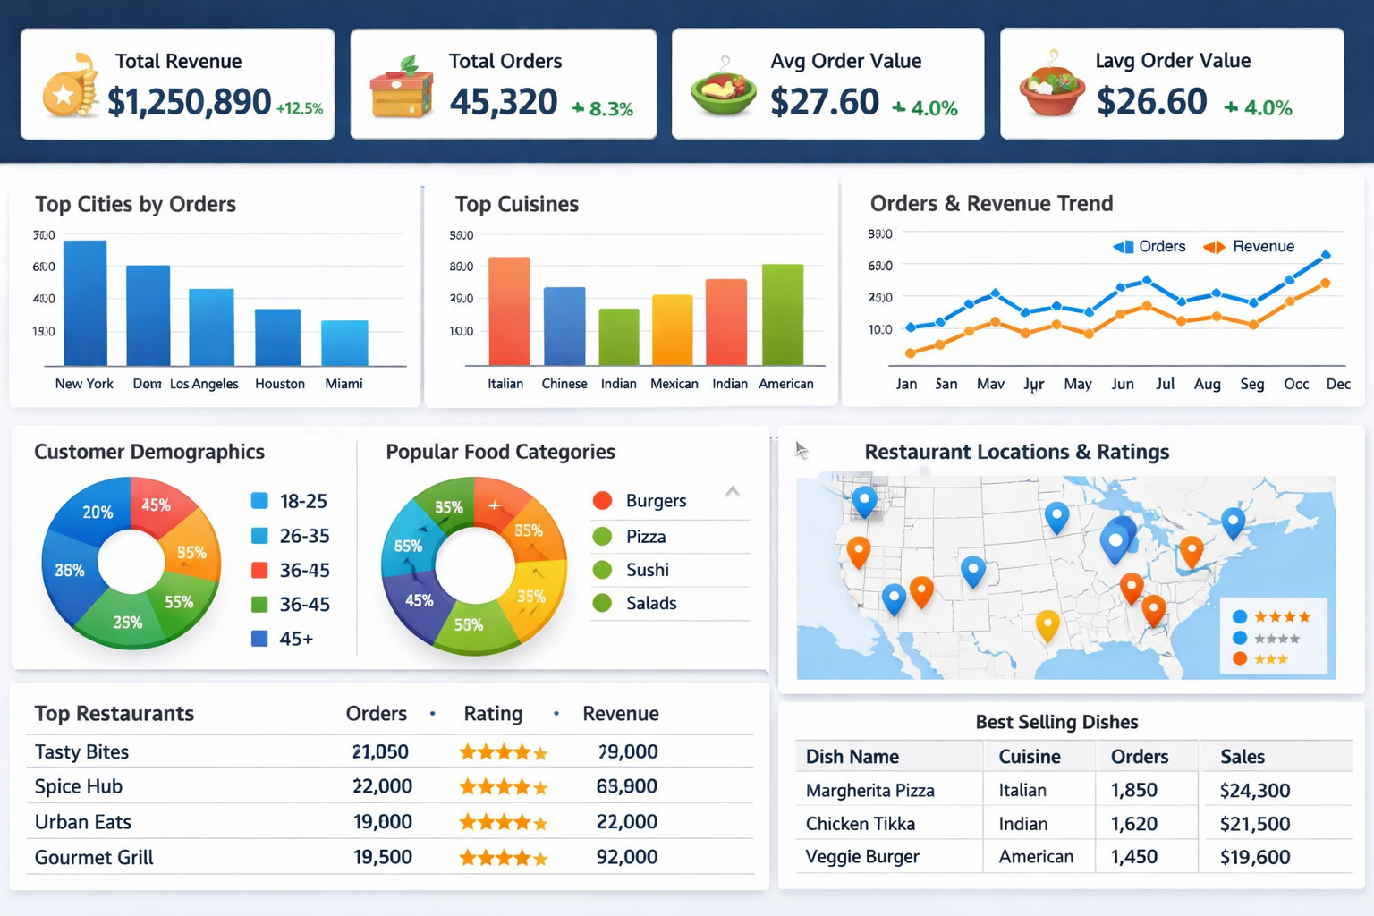
Top Visualizations Used in the Project
KPI Cards – Revenue, Orders, Average Order Value
• Bar Charts – City, Cuisine, and Restaurant-wise performance
• Line Charts – Order and revenue trends over time
• Donut & Pie Charts – Demographic and food category analysis
• Maps – Geographic distribution of restaurants and ratings
• Tables & Matrix – Detailed restaurant and product-level insights

Slide 4
Project Execution Milestones
Milestone 1 (Data Foundation): Performed ETL (Extract, Transform, Load) processes in Power Query to clean the dataset and establish a robust Star Schema.
Milestone 2 (Core Metrics): Developed the Business Snapshot, Customer Analysis, and Restaurant Performance views (Business overview, Customer Analysis, Restaurant Performance) to track high-level KPIs.
Milestone 3 (Product Intelligence): Constructed the Menu Analysis and Product Trends views (Food vs Menu, Ordering Insights), focusing on item popularity and price sensitivity.
Milestone 4 (Operational Strategy): Finalised the Demographic Profiling and Geographic Mapping views (Customer Demographics, Customer Loyality) to provide actionable location-based insights.

Slide 5
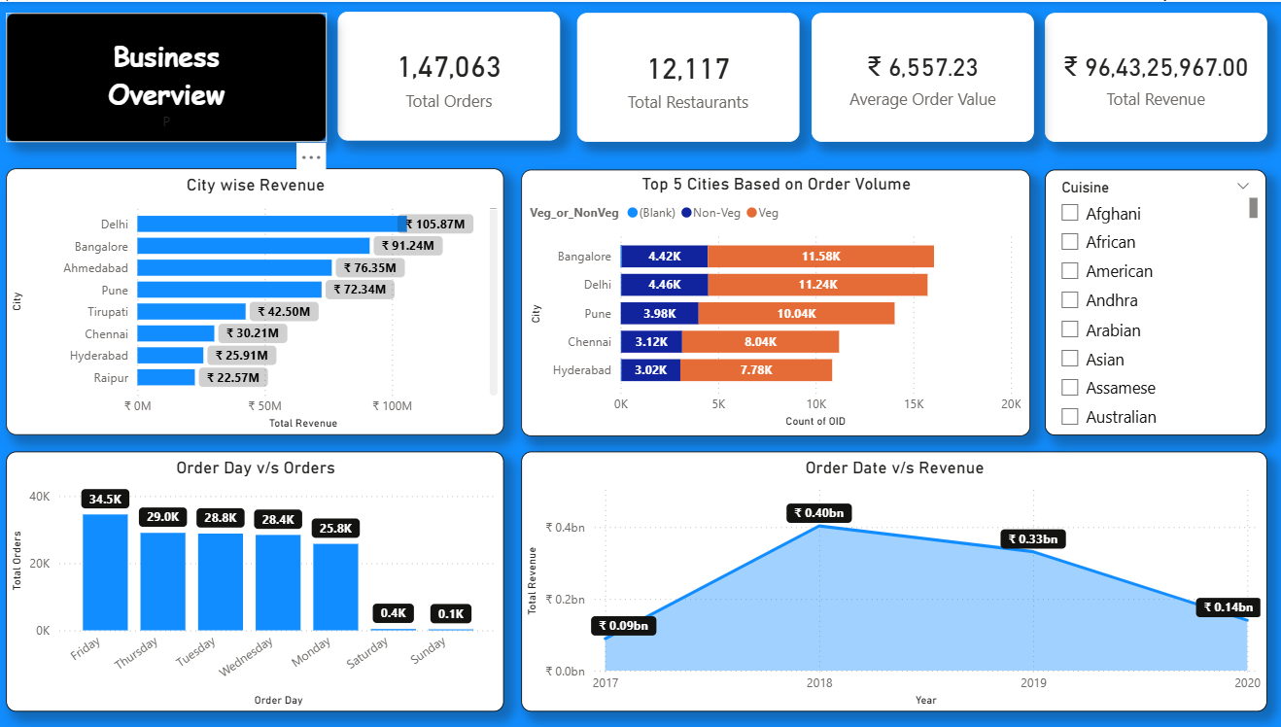
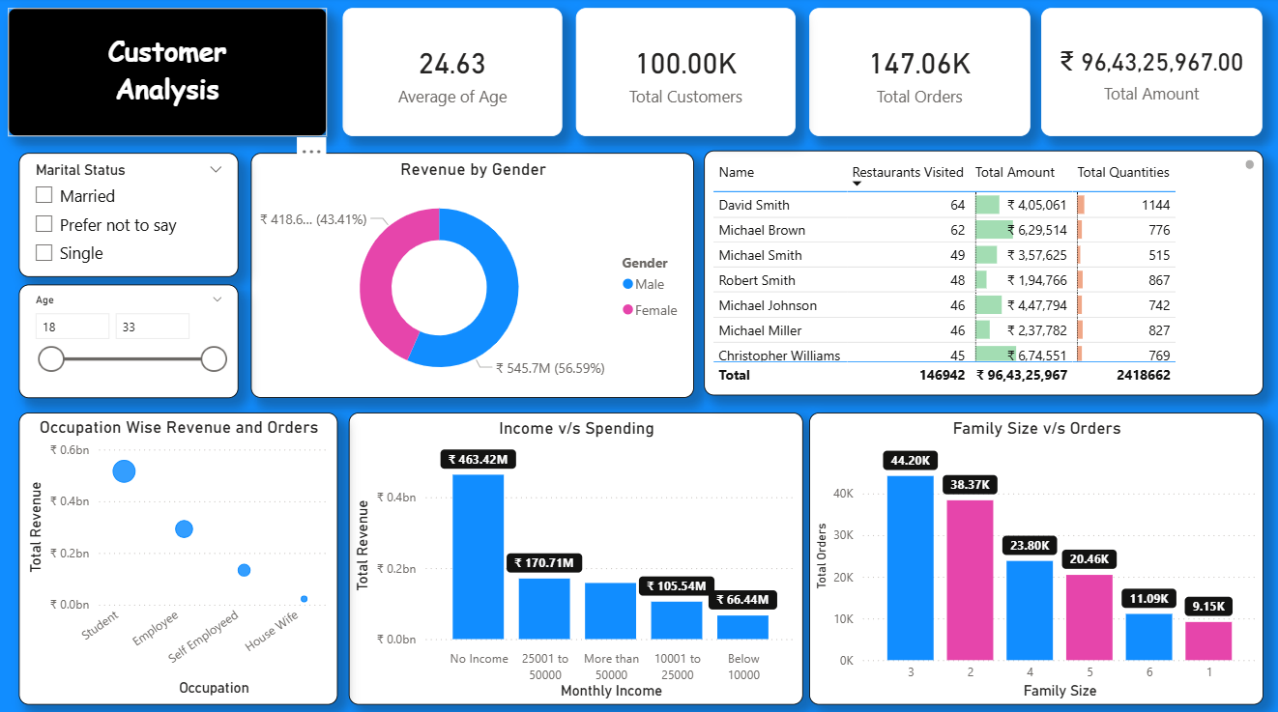
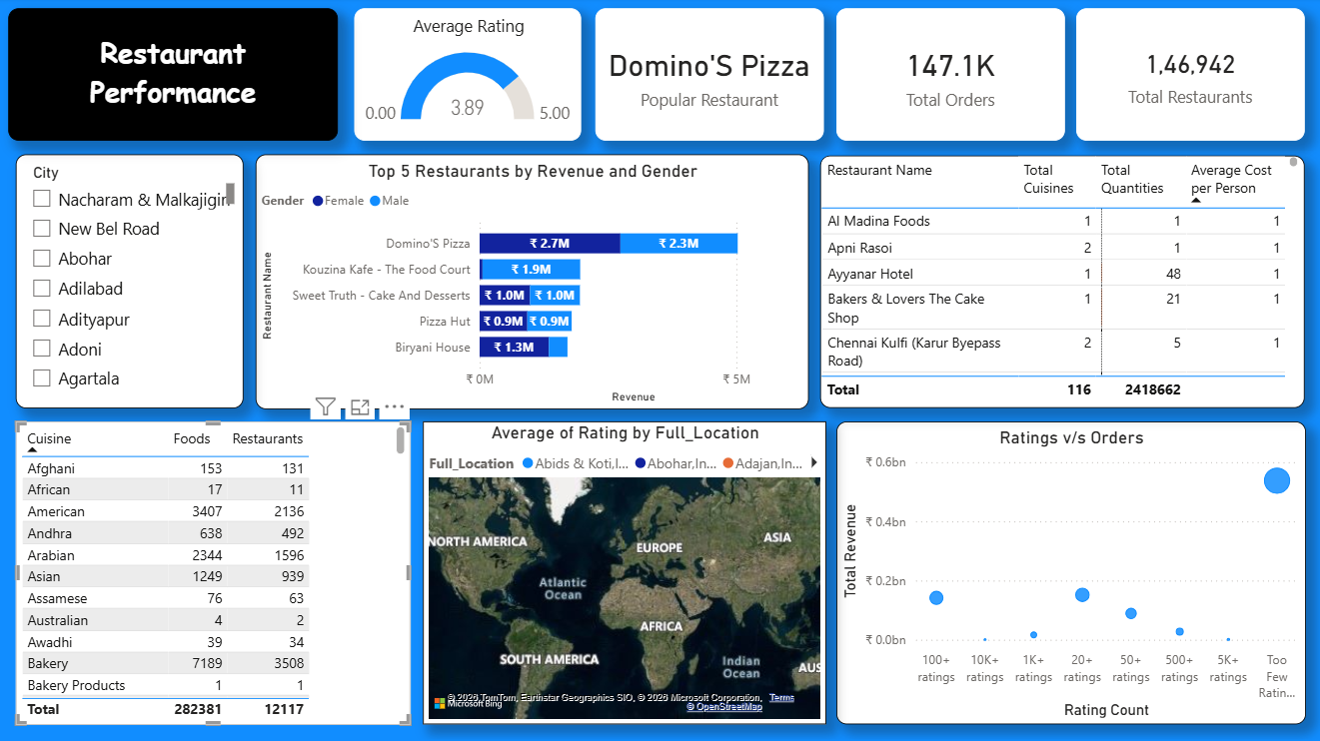
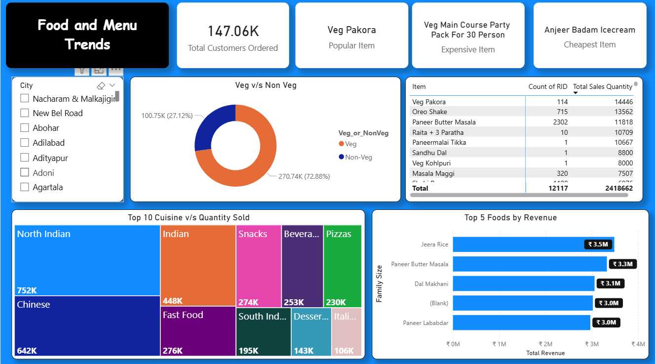
Dashboard Images

Slide 6
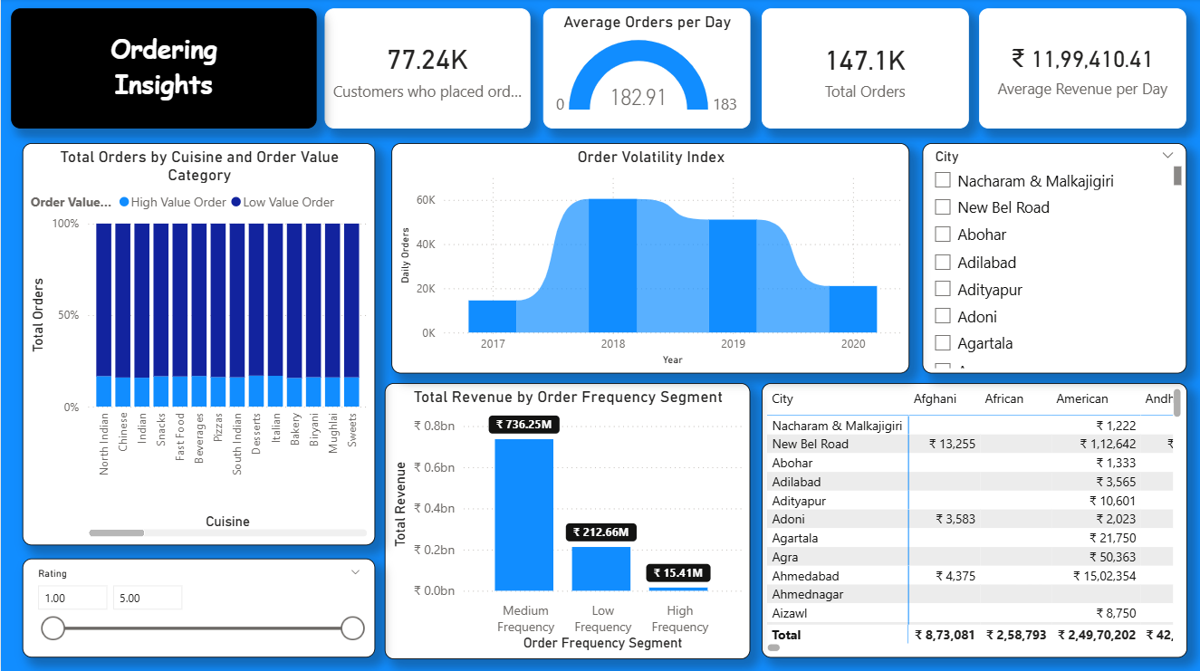
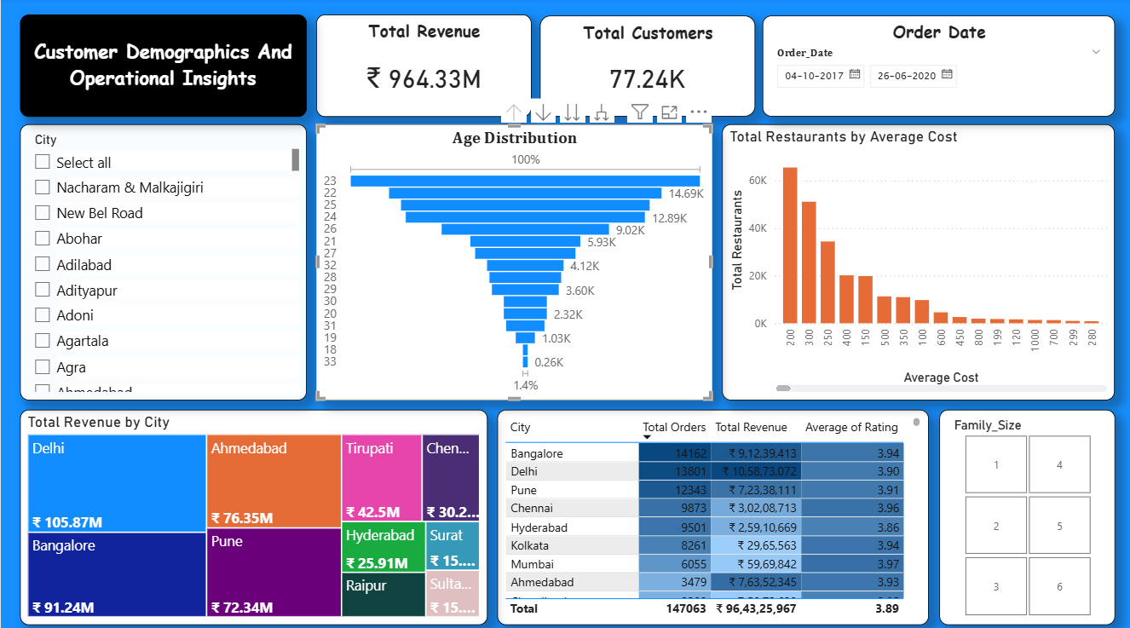
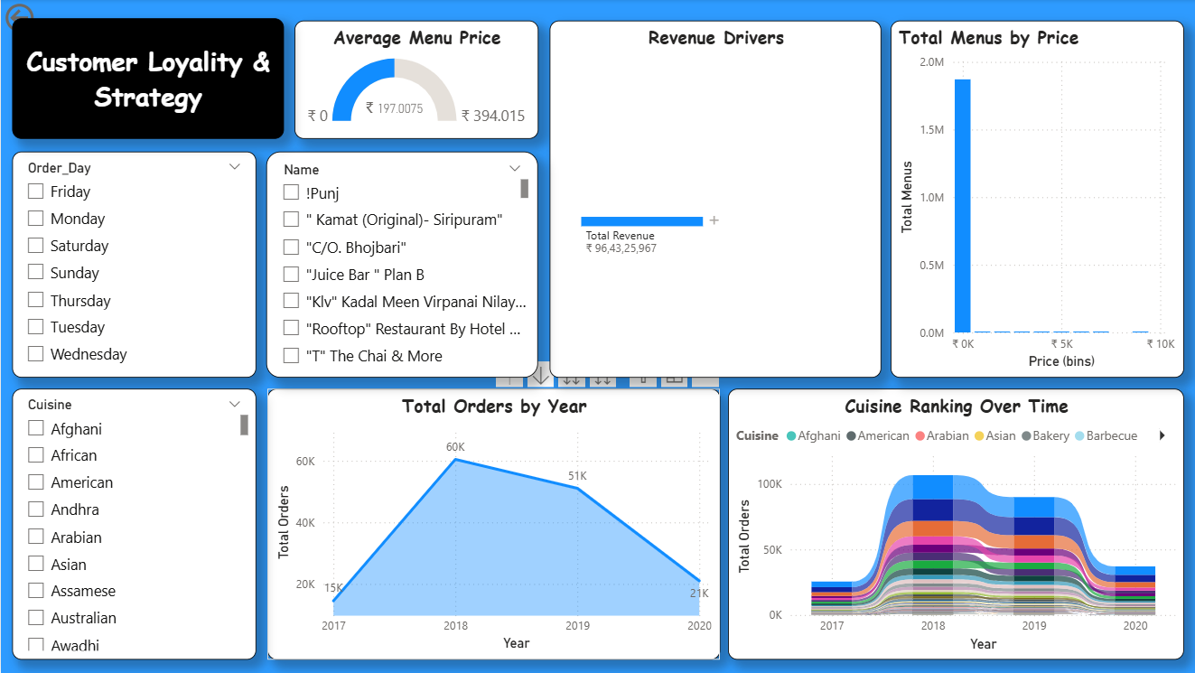

Slide 7
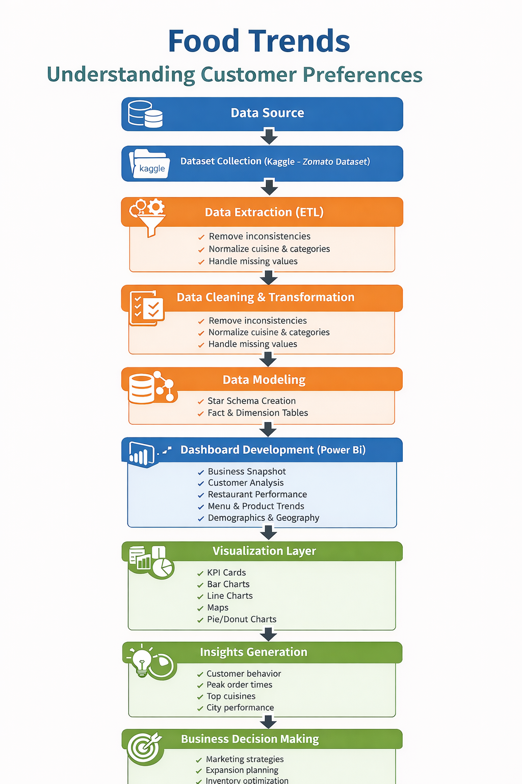
Project WorkFlow

Slide 8
Dataset (Source Name)
Source: Kaggle ( Zomato Dataset)
Total Revenue Analyzed: ₹96.43 Crores
Data Volume: 147,402 unique orders across 12,117 restaurants
Key Parameters:
Temporal: Order Date, Time of Day.
Demographic: User Age, Gender, Family Size, Marital Status.
Geographic: City, Location Coordinates, Ratings.
Financial: Sales Amount, Order Quantity, Item Price.

Slide 9
Challenges Faced and Resolution
Challenges
Resolutions
System Performance: High row count
(1.4 Lakh+) caused slow visual rendering
Optimized the data model by removing redundant columns and utilizing DAX Measures instead of calculated columns to reduce memory overhead
Data Inconsistency: Encountered non-standardised entries in "Cuisine" and "Veg/Non-Veg" fields
Applied Fuzzy Grouping and conditional columns in Power Query to normalize categories

Slide 10
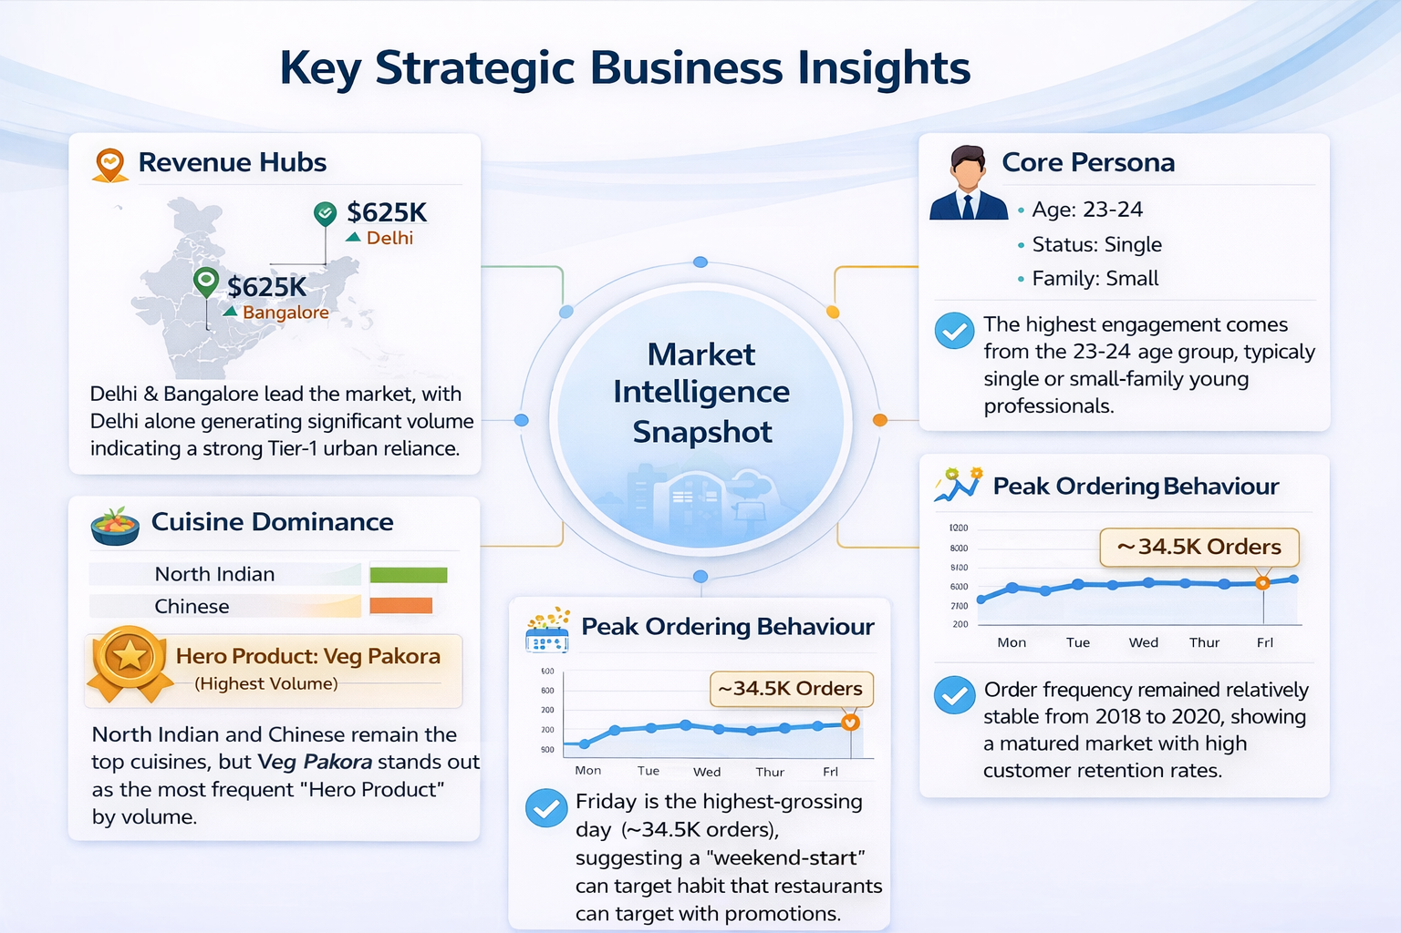

Slide 11
Feature Enhancements
Advanced Geospatial Analysis: Integrated interactive maps on Page 7 to visualize restaurant density vs. average ratings.
Dynamic Demographic Filtering: Added the ability to slice the entire dashboard by Marital Status and Age Groups to see hyper-local trends.
Volatility Indexing: Created a custom visual to track order fluctuations, allowing businesses to predict staffing needs based on order spikes.
User Persona Branding: Used custom formatting to distinguish between high-value "Premium" customers and high-frequency "Budget" customers.

Slide 12
Conclusion
Revenue growth is mainly driven by young urban customers aged 20–25. This segment forms the core customer base in Tier-1 cities.
Friday and weekend orders are significantly higher than other days. This shows a strong weekend-start consumption pattern.
Peak-day demand allows better logistics and staffing planning. Restaurants can optimise inventory and delivery operations accordingly.
North Indian cuisine contributes the highest order volume. It acts as a stable and consistent revenue driver.
Snack items like Pakoras show high demand during peak hours. Expanding snack combos can increase sales during Fridays.
Tier-1 city expansion offers strong growth potential. Personalized loyalty programs can improve retention and ROI.

Slide 13
Acknowledge and References
I want to express our heartfelt gratitude to:
Infosys Springboard Team– for organising this valuable internship opportunity.
Our Mentor– for her continuous support and feedback.
My Teammates – for collaboration, encouragement, and insights.
This internship has been a significant step in our professional growth and technical journey References:
Kaggle Zomato Dataset
Microsoft Power BI Documentation
Infosys Springboard Virtual Internship course materials

Slide 14
Thank You

